Slide 1


MEXE 23-038
Kinematics and Control of a Six Degrees of Freedom Robotic Manipulator
Dhan Rence C. Amurao | Hannie Rose R Lontoc | Angelica A. Perlas | Emanuel F. Saez | Caitlin Mari D. Umali
Engr. Janice F. Peralta
Engr. Mikko A. De Torres

Slide 2
c
CHAPTER 1
INTRODUCTION
The study focuses on the entire process of developing a 6-DOF manipulator, beginning with the design phase. This entails comprehending the structure and articulating the forward kinematics equations using mathematical models such as the Denavit-Hartenberg representation. This representation is critical in interpreting the connections between the robot's joints and their motions, allowing control to be more easily implemented. Following that, the design is subjected to rigorous modeling and testing processes, which evaluate its performance in numerous circumstances to guarantee optimal functioning.

Slide 3
CHAPTER 1
RESEARCH OBJECTIVES
1. Design a Six Degrees of Freedom Robotic Manipulator which includes:
1.1 Kinematic Diagram
1.2 D-H Parametric Table
1.3 Physical Systems Model/ 3D Structure
2. Simulate the 6-DOF manipulator integrating a control for the 3D Model.
3. Evaluate the robotic manipulator in 5 target points.

Slide 4
CHAPTER 1
SCOPE AND DELIMITATIONS
The scope includes designing the 6-DOF robotic manipulator with SolidWorks and meeting the design requirements and specifications for each joint and component.
The research contains designing an end-effector controller for precise manipulator movement control using CoppeliaSim.
To evaluate the 6-DOF robotic manipulator at five predetermined points to determine its adaptability and functionality in a variety of scenarios.
The delimitation of this study acknowledges the complexities of analyzing the mathematical methods of the Inverse Kinematics of a 6-DOF robotic manipulator, as well as the subsequent prototyping procedures.

Slide 5
CHAPTER 3 & 4
OBJECTIVE 1
Design a Six Degrees of Freedom Robotic Manipulator which includes:
1.1 Kinematic Diagram
1.2 D-H Parametric Table
1.3 Physical Systems
A. Methodology
1.1 Kinematic Diagram
Establish the Kinematic Diagram which illustrates the connectivity of joints and links of the robotic manipulator that is essential in the Denavit-Hartenberg method.
1.2 D-H Parametric Table
Assigning of the Denavit-Hartenberg coordinate frames and intersection of x, y and z axes which includes the parameter theta, alpha, r and d.
1.3 Physical Systems
Thorough evaluation and careful selection of components such design requirements, specifications, and considerations for the 6 DOF Robotic Manipulator. Next, is to design the mechanical structure of the Robotic Manipulator in SolidWorks.

Slide 6
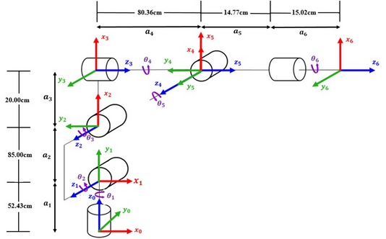
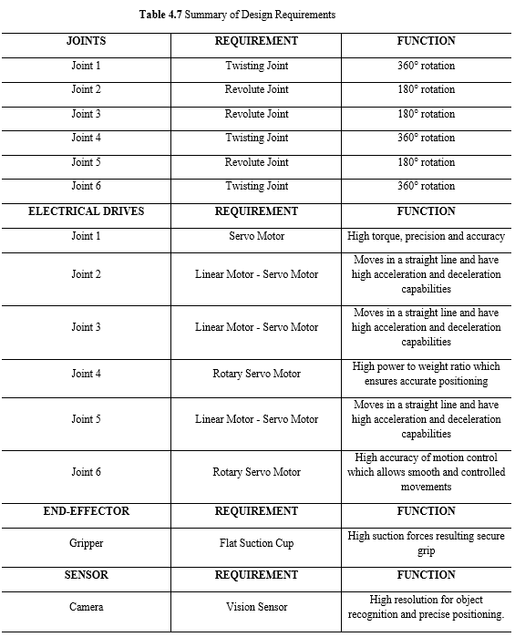
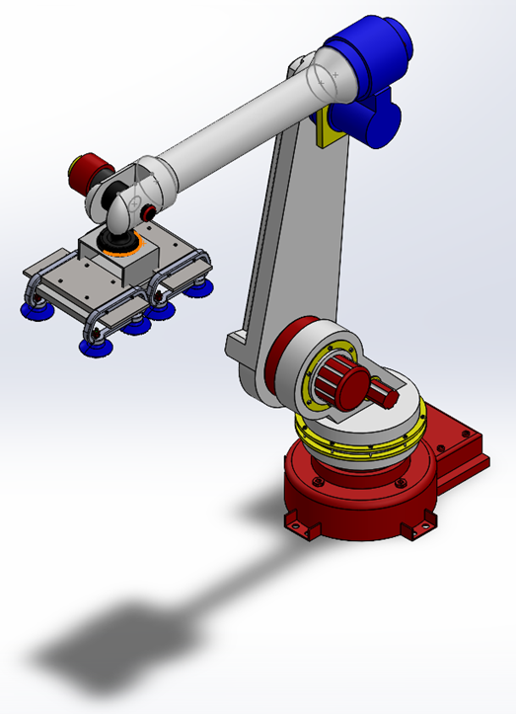
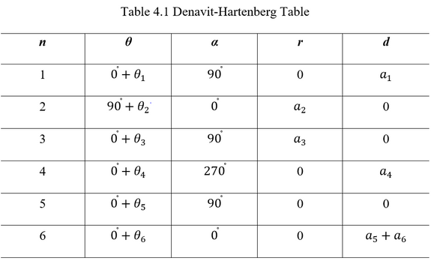
CHAPTER 3 & 4
OBJECTIVE 1
B. Results
1.1 Kinematic Diagram
1.3 Physical Systems
1.2 D-H Parametric Table

Slide 7
CHAPTER 3 & 4
OBJECTIVE 1
C. Conclusion
1.1 Kinematic Diagram
Established Kinematic Diagram of the 6 DOF Robotic Manipulator including link lengths measurements and D-H Frame Assignments, which will be used to construct the D-H Parametric Table.
1.2 D-H Parametric Table
Established D-H parametric table with the corresponding parameters. Values obtained is then used to generate the Homogeneous Transformation Matrix for each joint.
1.3 Physical Systems
Developed the design of the 6 DOF Robotic Manipulator in SolidWorks considering the design requirements, specifications and considerations that are required for the 6-DOF Robotic Manipulator to be implemented successfully.

Slide 8
CHAPTER 3 & 4
OBJECTIVE 2
Simulate the 6-DOF manipulator integrating a control for the 3D Model.
A. Methodology
Importing the SolidWorks file to CoppeliaSim. Then, a comprehensive simulation process of the five (5) target position in CoppeliaSim by inputting the obtained position vectors, showing graphs which displays joint angles and end-effector velocity.

Slide 9
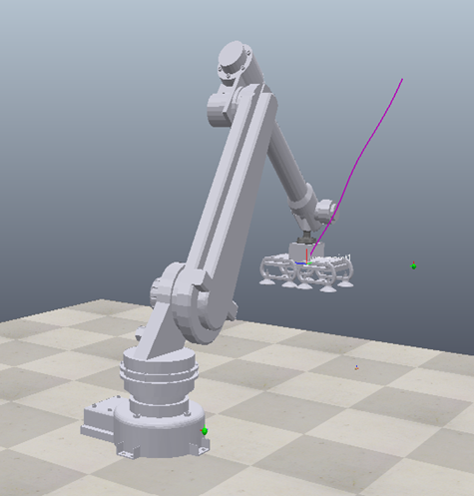
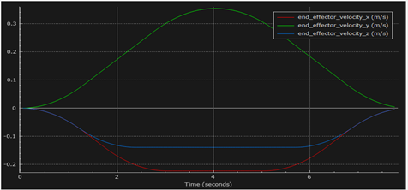
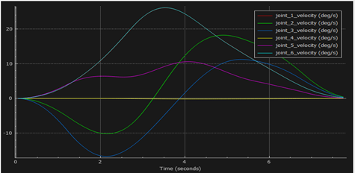
CHAPTER 3 & 4
OBJECTIVE 2
B. Results

Slide 10
CHAPTER 3 & 4
OBJECTIVE 2
C. Conclusion
Executed the simulation through CoppeliaSim and achieved the task of reaching the five (5) target position with its respective graphs of end-effector velocity and joint angles velocity.

Slide 11
CHAPTER 3 & 4
OBJECTIVE 3
Evaluate the robotic manipulator in 5 target points.
A. Methodology
Assessment of the manipulator's behavior and performance in the virtual environment. The GUI calculator and Peter Corke's Robotic Toolbox for Forward Kinematics along with the link lengths, joint angles and position vector. Next, is to assess the obtained position vector in CoppeliaSim.

Slide 12
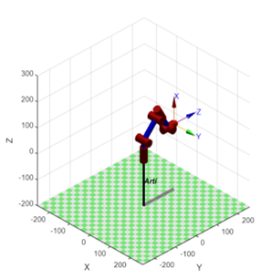
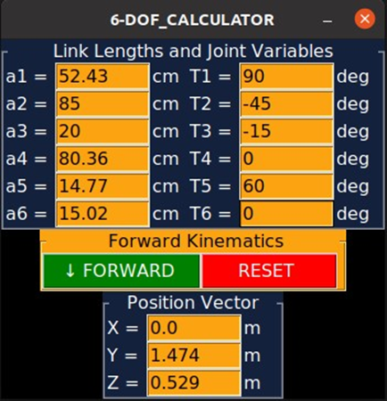
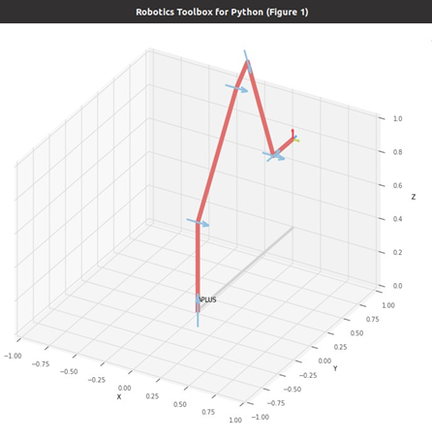
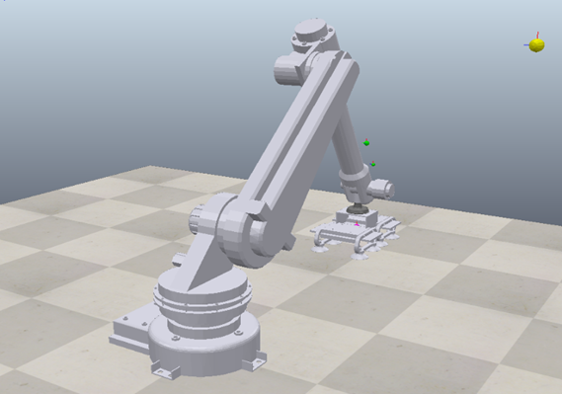
CHAPTER 3 & 4
OBJECTIVE 3
B. Results

Slide 13
CHAPTER 3 & 4
OBJECTIVE 3
C. Conclusion
The GUI Calculator and Peter Corke’s Robotic Toolbox were able to provide the values of Forward Kinematics to be used for the validation of the manipulator's movement in CoppeliaSim. As well as the equivalent matrix from the assigned joint angles for each test. Through these tools, the values obtained from tests are equal, ensuring the accuracy and reliability of the manipulator's performance.

Slide 14
c
CHAPTER 5
SUMMARY OF FINDINGS
1. The researchers used aluminum 6061 alloy as it is the best and suitable fabrication material for the robotic manipulator due to its workability, higher tensile strength, more impact-resistant, weight advantage, and flexibility.
2. The researchers used servo motor as an electrical driver for the base part, linear motor-servo motor for the Joints 2, 3, and 6, and rotary servo motor for Joints 4 and 6; these mechanism components are known for to be the most suited for the robotic manipulator.
3. The researchers acquired the weight of the assembled 6-DOF robotic manipulator with 108.68939 kilograms.
4. The researchers used evaluate feature under SolidWorks to determine the height of the robotic manipulator, which is 156.43 cm

Slide 15
c
CHAPTER 5
SUMMARY OF FINDINGS
5. The researchers used SolidWorks to create the initial and final design of the 6-DOF Robotic Manipulator.
6. The researchers used CoppeliaSim to simulate the robotic arm by visualizing its movements; 180 degrees and 360 degrees rotation.
7. The researchers validated that the degrees of freedom have a value of 6 utilizing Grubler’s Criterion.
8. For the kinematic analysis, the researchers computed the value of joint variables using the D-H Notation.
9. For the evaluation part, the researchers assigned 5 target points to test the kinematics of the manipulator and validated the results using Python and MATLAB.

Slide 16
c
CHAPTER 5
RECOMMENDATION
1. The proponents strongly encourage the continuation of this research study.
2. The proponents suggest the future researchers to explore and apply other modeling and simulation software in their study.
3. For motion analysis, it is highly recommended to continue the robotic manipulator kinematics, such as by implementing Inverse Kinematics and establish the Working Envelope of the Robotic Manipulator.
4. Future researchers are recommended to implement the Jacobian Matrix to improve the study.
5. Future work that includes actual testing and development of the study's prototype is highly suggested.

Slide 17

MEXE 23-038
THANK YOU

